Slide 1
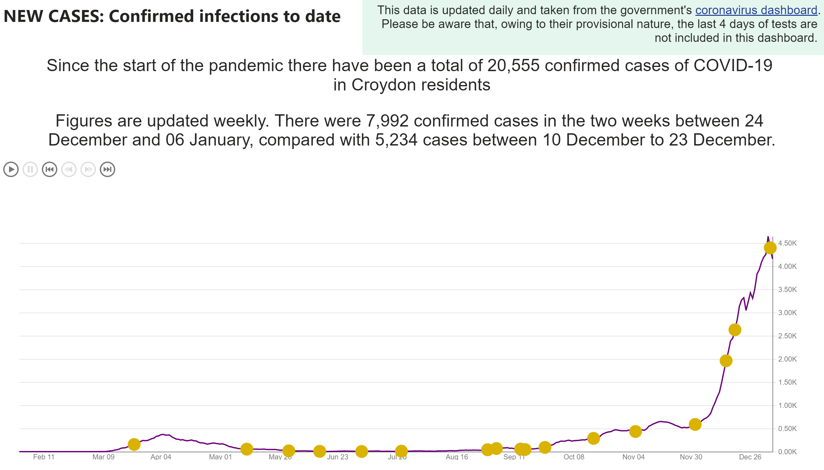
Cases and events
Notes:
card
No alt text provided.
textbox
No alt text provided.
card
No alt text provided.
Weekly number of registered deaths by date of death in Croydon compared to the five-year average
No alt text provided.
textbox
No alt text provided.

Slide 2
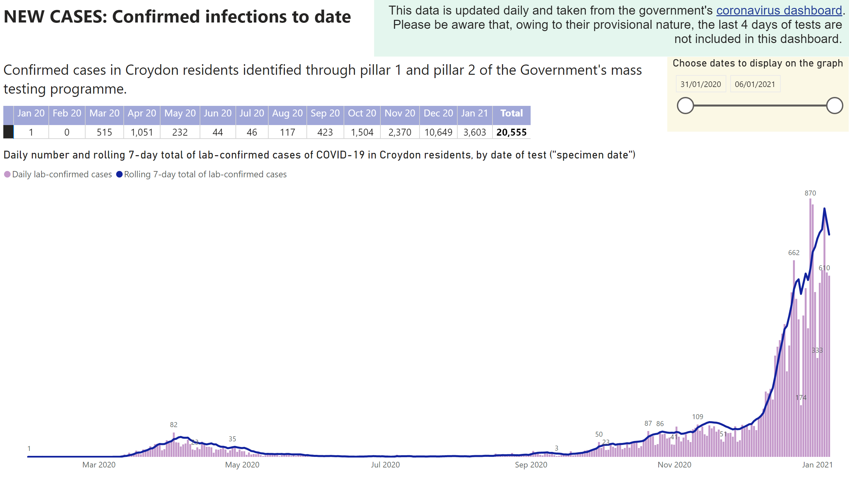
Infections
Notes:
textbox
No alt text provided.
textbox
No alt text provided.
Daily number and rolling 7-day total of lab-confirmed cases of COVID-19 in Croydon residents, by date of test ("specimen date")
No alt text provided.
Choose dates to display on the graph
No alt text provided.
pivotTable
No alt text provided.
textbox
No alt text provided.

Slide 3
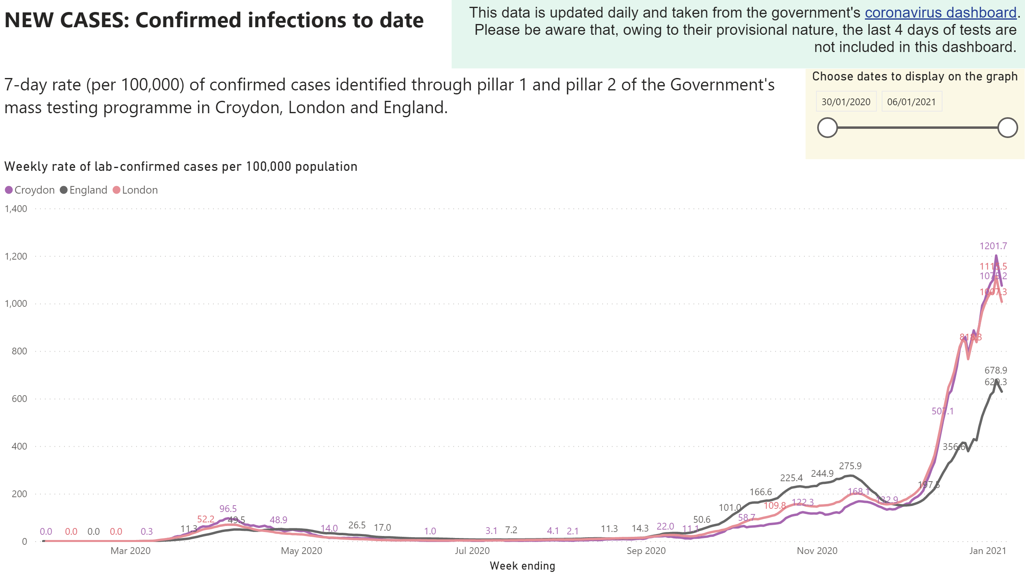
Infection rates

Slide 4
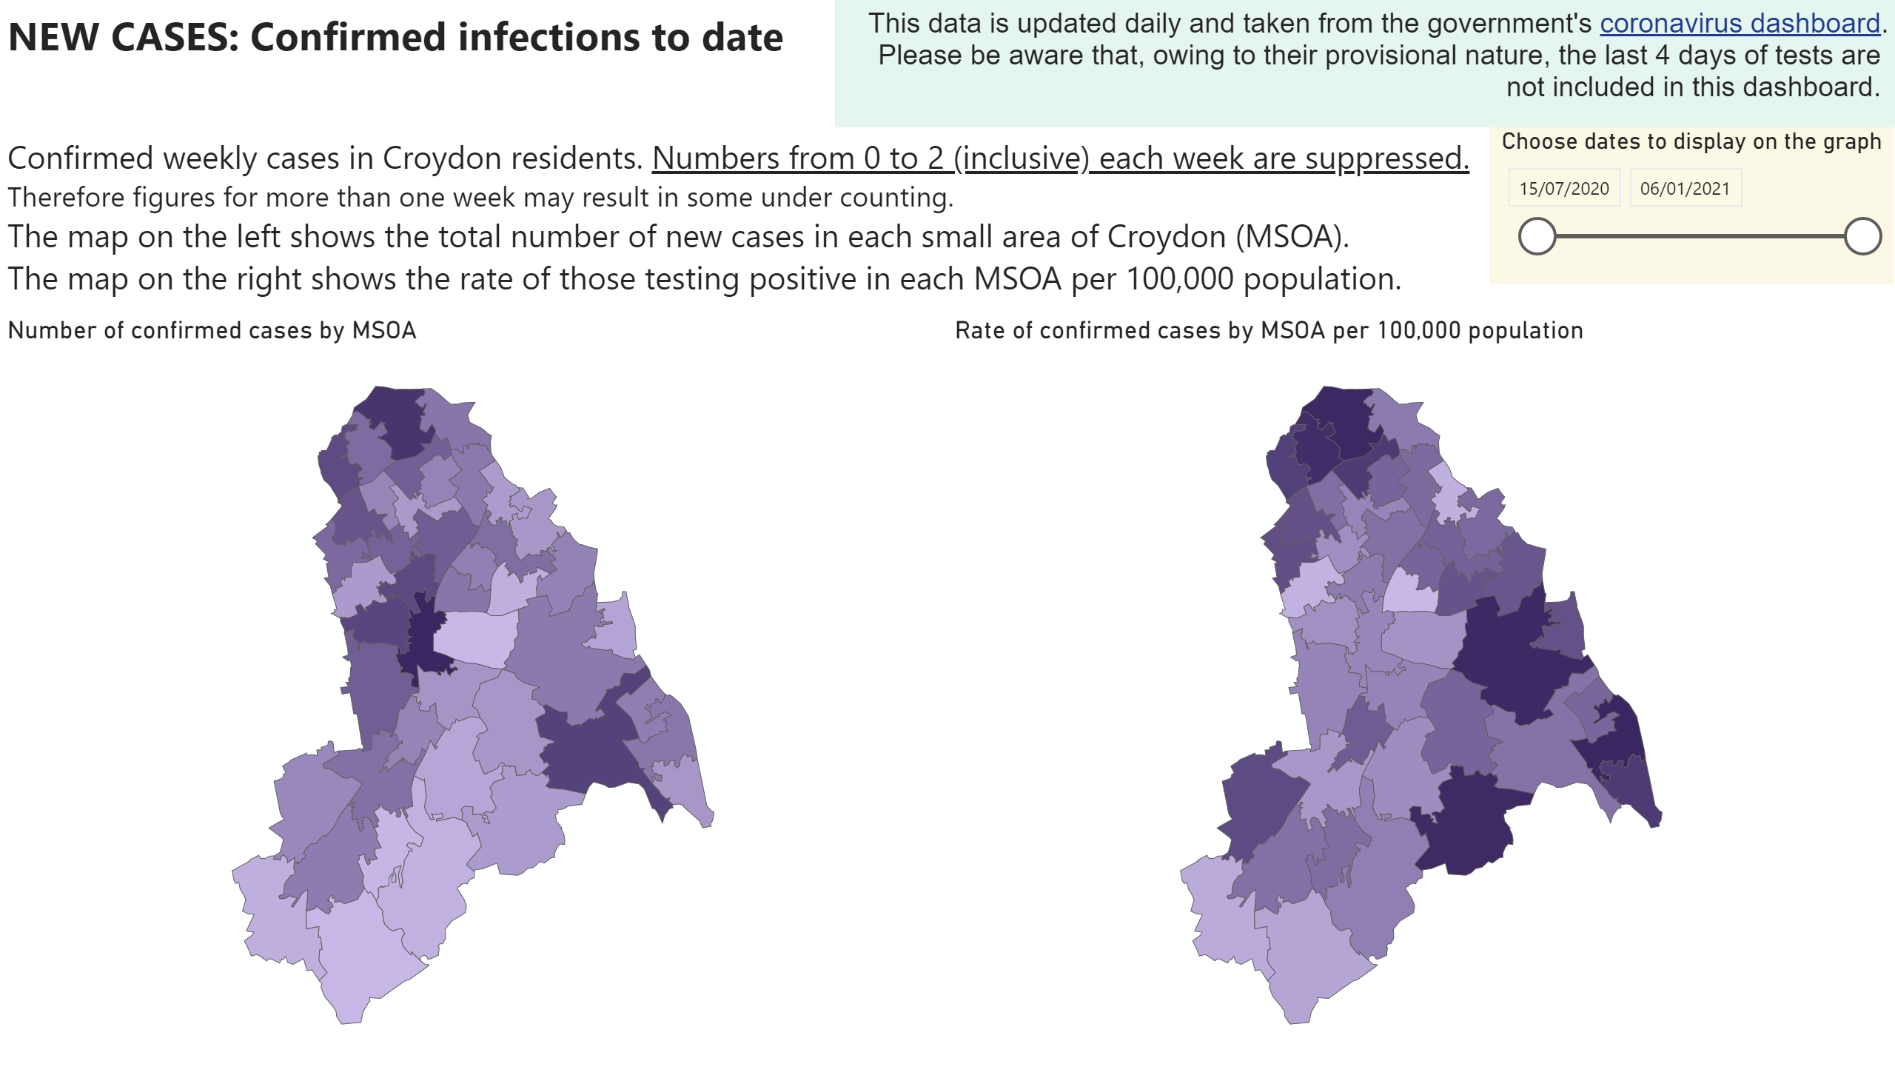
Infections map

Slide 5
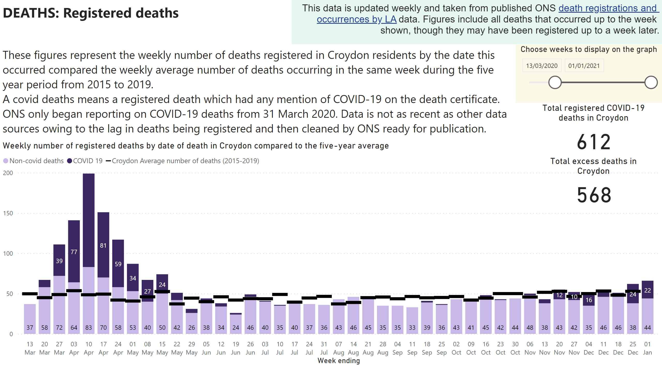
Registered deaths
Notes:
textbox
No alt text provided.
textbox
No alt text provided.
Weekly number of registered deaths by date of death in Croydon compared to the five-year average
No alt text provided.
Total excess deaths in Croydon
No alt text provided.
Total registered COVID-19 deaths in Croydon
No alt text provided.
Choose weeks to display on the graph
No alt text provided.
textbox
No alt text provided.

Slide 6
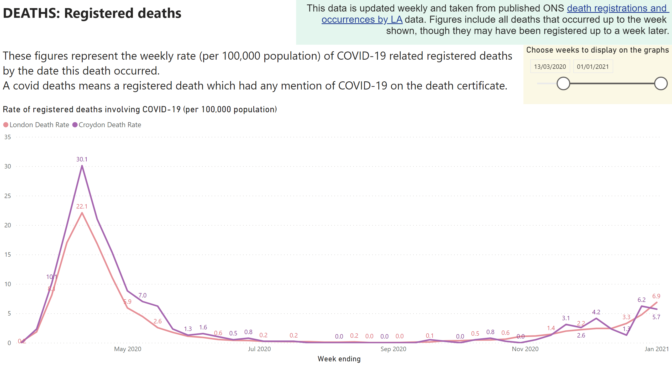
Registered death rates
Notes:
textbox
No alt text provided.
textbox
No alt text provided.
Rate of registered deaths involving COVID-19 (per 100,000 population)
No alt text provided.
Choose weeks to display on the graphs
No alt text provided.
textbox
No alt text provided.

Slide 7
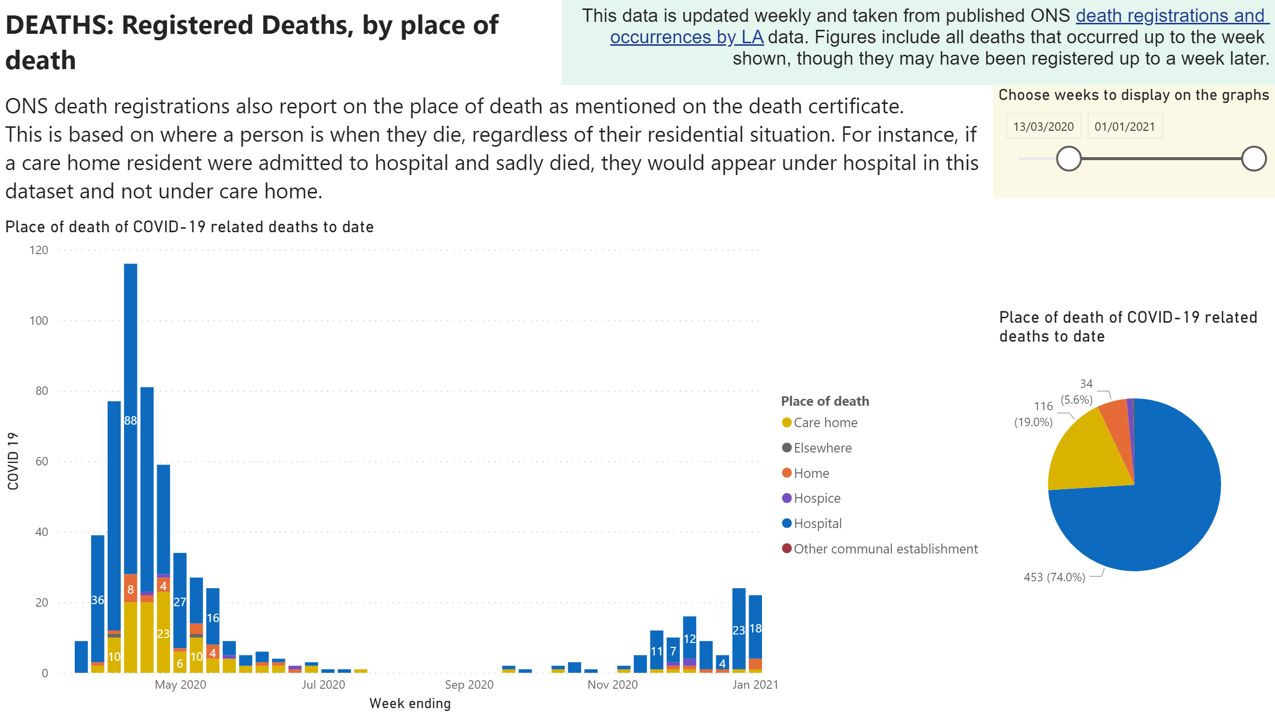
Place of registered death
Notes:
textbox
No alt text provided.
textbox
No alt text provided.
Place of death of COVID-19 related deaths to date
No alt text provided.
Place of death of COVID-19 related deaths to date
No alt text provided.
textbox
No alt text provided.
Choose weeks to display on the graphs
No alt text provided.

Slide 8
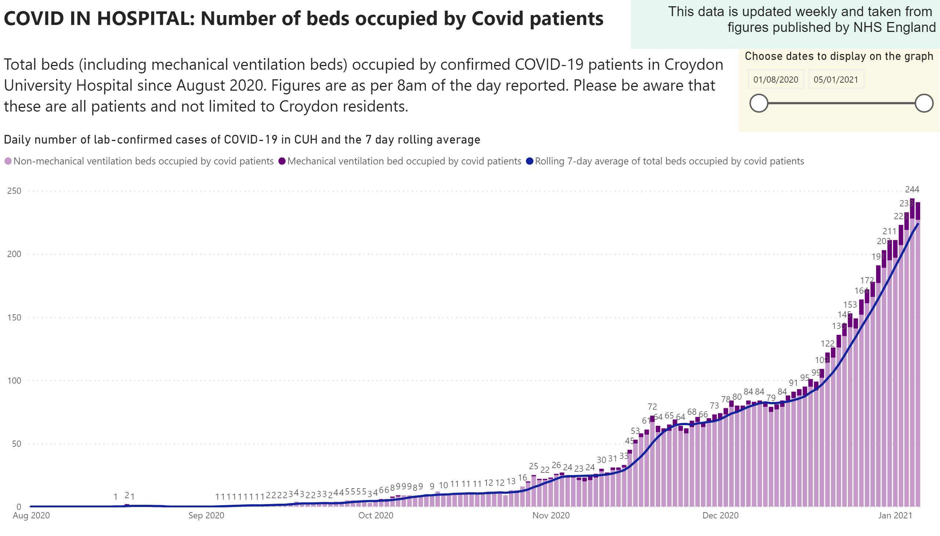
Hospital Inpatients

Slide 9
Other Data Sources
Notes:
textbox
No alt text provided.
textbox
No alt text provided.
textbox
No alt text provided.

